Slide 1
Project Uzaylilar:
Revolutionizing Tourism with a Futuristic Space Travel Website
TEAM MEMBERS
Ghada Noor
Syed Zaid Zubair
Muhammad Abdullah
Ashar Ali Khan
Muhammad Mubin Farid
Muhammad Taha Zaman

Slide 2


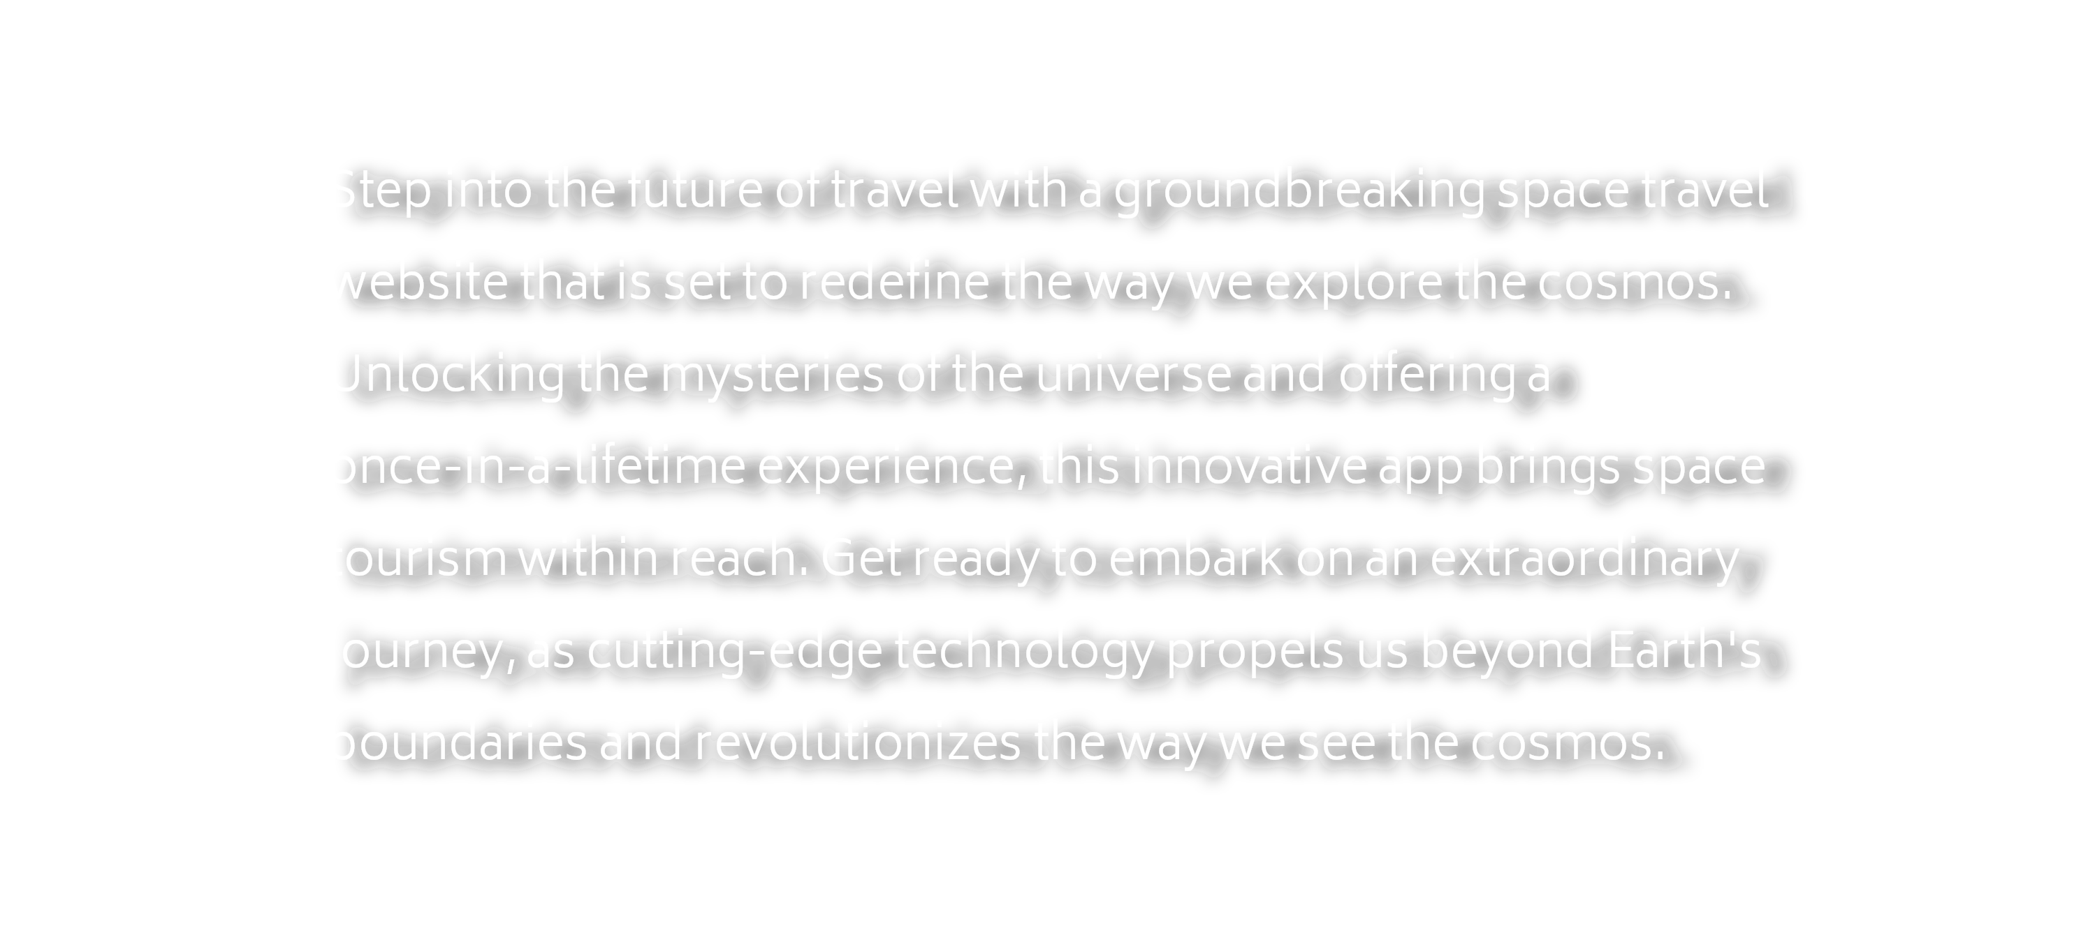

Slide 3
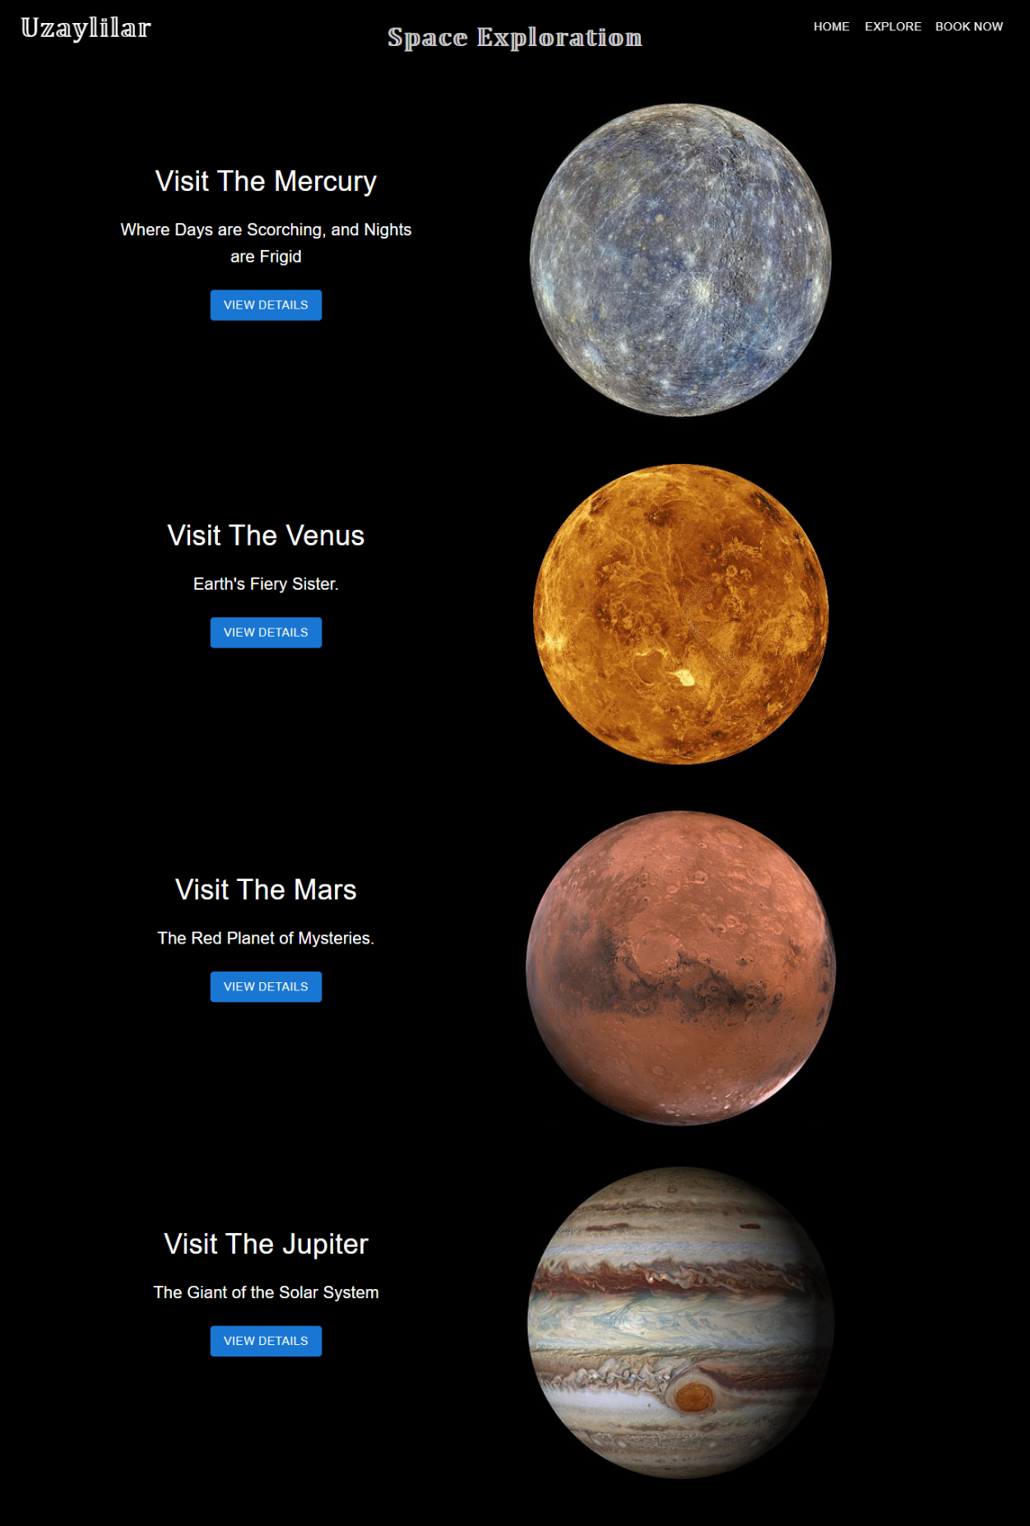

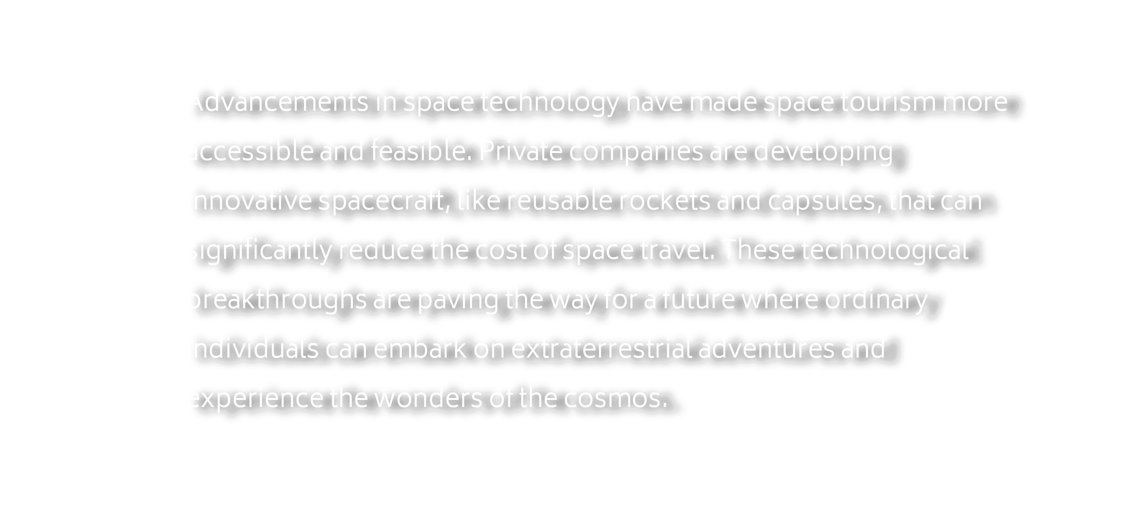

Slide 4


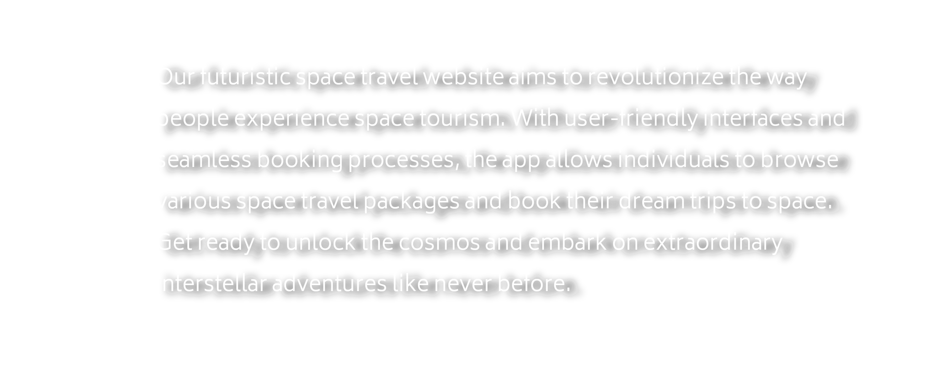

Slide 5
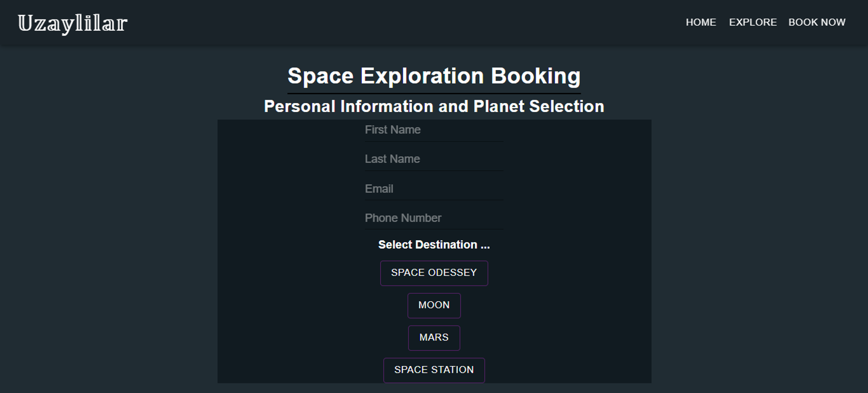

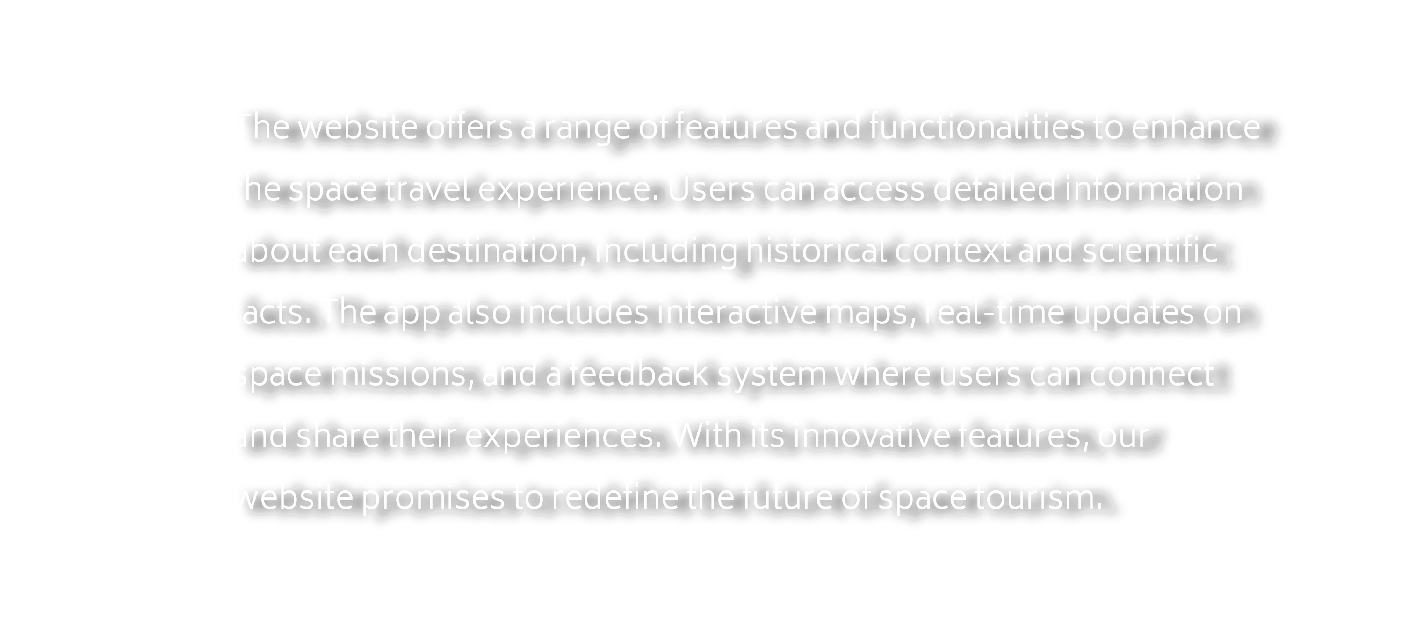

Slide 6
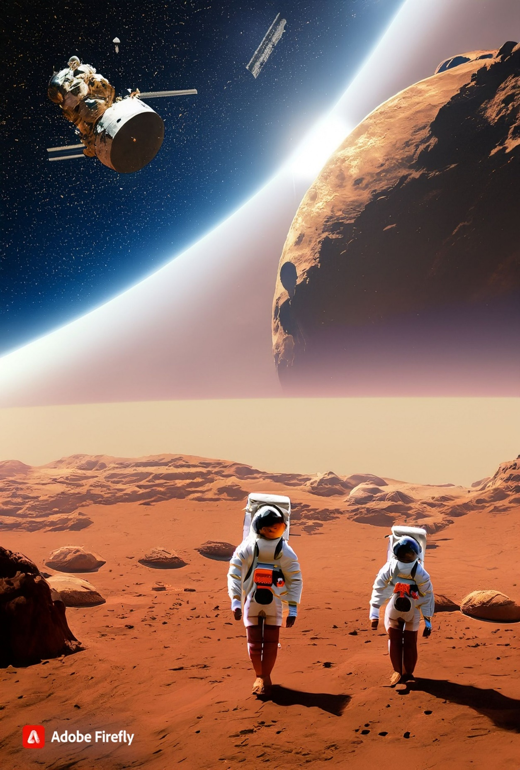

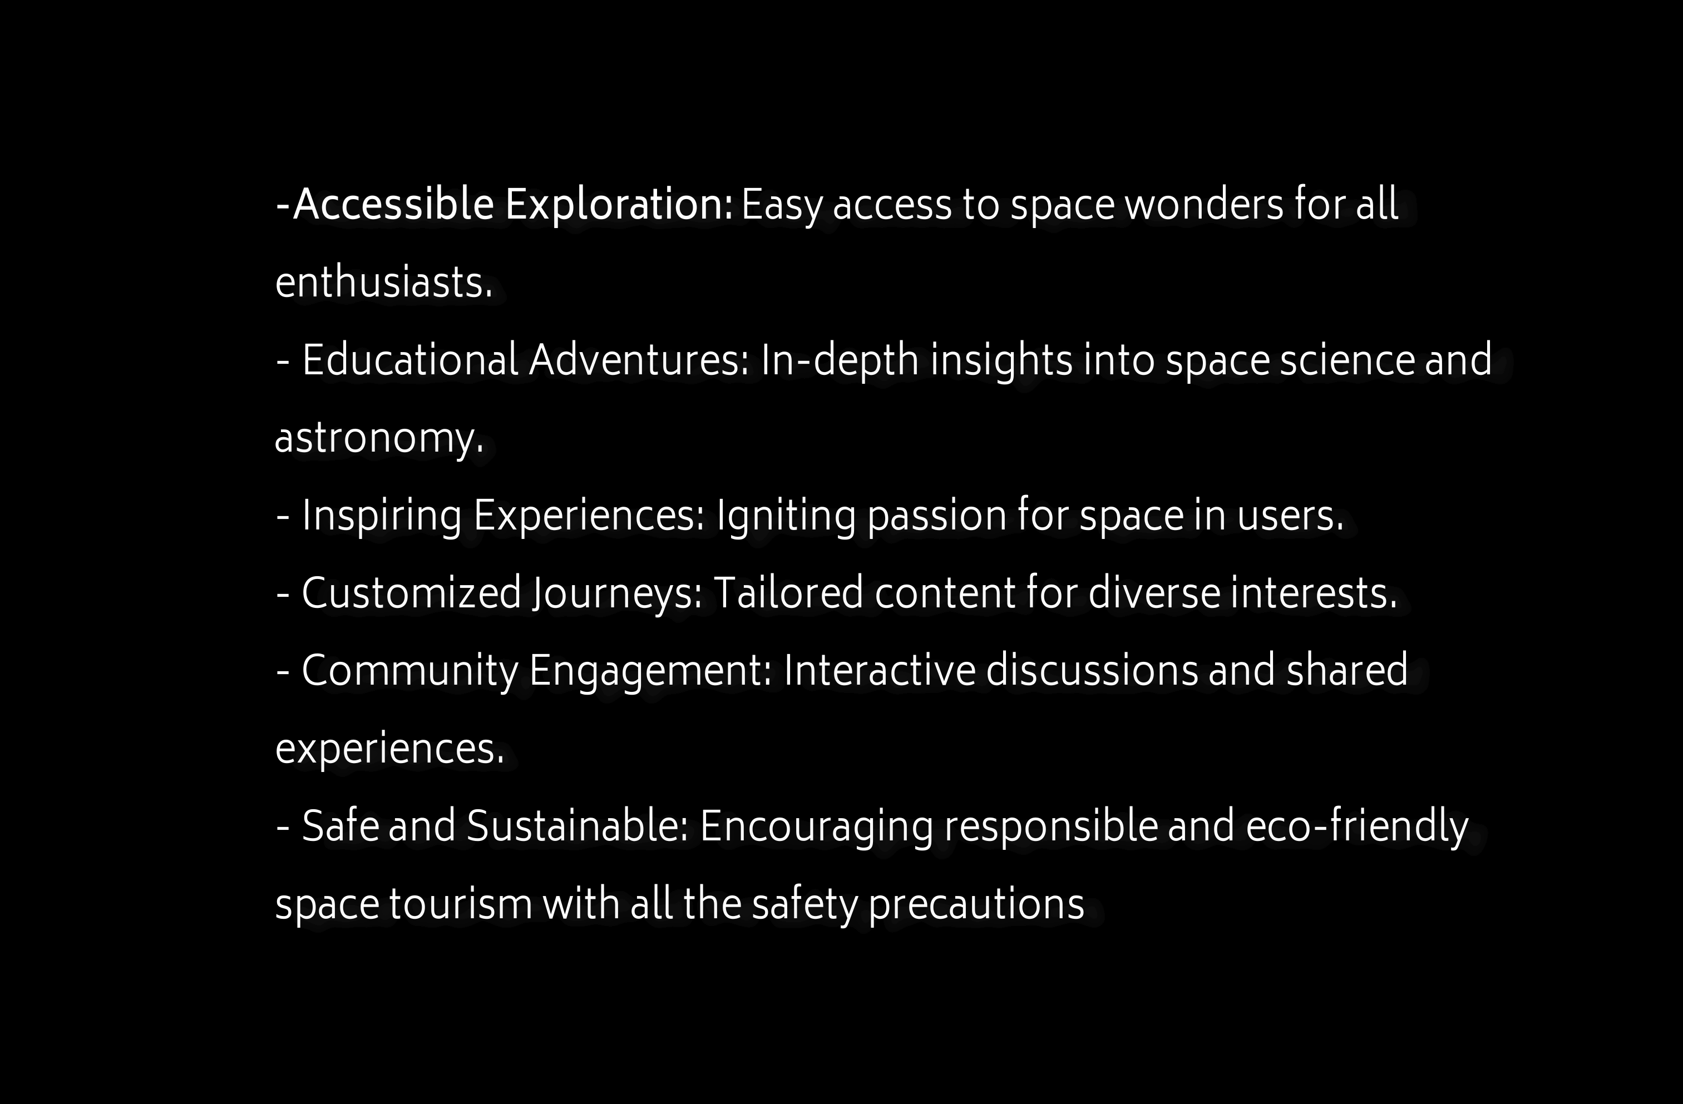

Slide 7


